Slide 1
NetApp Shared NAS Architecture for VMware
6080 Primary Filers
9/3/08

Slide 2
Quick Facts
Architecture
  NetApp Dual Head 6080 Implementation on shared filers
Scale
  3.25TB to 6.5TB Usable Disk
Prerequisites
  NetApp Secondary filers with snapvault licenses
Aggregate
  One dedicated aggregate per (2) VMware farms
Volumes
  Flexvols that are thin provisioned and deduplicated
Notes:
3 volumes with snapshots per raid group (assuming 1 VMware cluster per raid group), and volumes are being sized at 3400GB (one raid group in size)

Slide 3
Filer Configuration
Shelf Configuration
Minimum 2 Shelves of Disk per VMware cluster – 28 Drives
  NetApp DS14 – 14 Drives per shelf
  300GB 15,000RPM Drives
  Dual Attached Fibre Loops
Maximum 4 Shelves of Disk per VMware cluster– 56 Drives

Slide 4
Aggregate Setup
A separate aggregate will be created on a filer exclusively for VMware. The recommended criteria are as follows:
  The aggregate name will be AGGRX_THIN to distinguish that this is a thin provisioned aggregate.
  There will be 2 VMware farms that share one aggregate on a filer. The maximum size will be approximately 6.5TB of usable disk space for the VMware cluster.
Aggregates will be set up half full to start and grown when needed
  Minimum aggregates should be 15+2 (17 drive raidDP) – 300GB FC drives for approximately 3.25TB.
  Total of 34 drives to an aggregate
  No more than 1 VMware Aggregate to a single filer
Disks should be added to an aggregate a full raid stripe at a time
Notes:
3 volumes with snapshots per raid group (assuming 1 VMware cluster per raid group), and volumes are being sized at 3400GB (one raid group in size)

Slide 5
Volume Naming
Volume Name | Vol Size | Snap Reserve | Snapvault
Infra_<vmware_cluster>_vms_nosnap | 3400GB | 0% | No
Infra_<vmware_cluster>_vms_snap07 | 3400GB | 10% | Yes
Infra_<vmware_cluster>_vms_snap14 | 3400GB | 10% | Yes
Infra_<vmware_cluster>_vms_snap45 | 3400GB | 10% | Yes
Infra_<vmware_cluster>_vmw_nosnap | 3400GB | 0% | No

Slide 6
Volume Configuration
The following configuration settings apply for each volume:
  Set the volume guarantee to “none”.
  Each volume will need to be exported via NFS, with r/w and root privileges, to all nodes in the VMware ESX cluster that it is being provisioned for. *** Note that NFS exports need to be configured for access from the VMkernel interface on the VMware ESX servers, not the service console interface.
  Each volume that will use snapshots will need the following volume options set in order to allow access to the directories via CIFS on the SnapVault secondary systems for single file recovery:
  vol options <volname> create_ucode on
  vol options <volname> convert_ucode on

Slide 7
Volume Configuration
The following configuration settings apply for each volume:
CLI syntax will resemble:
Create the volume:
vol create Infra_<vmware_cluster>_vms_snap7 –l en_US –s none AGGRX_THIN 3400g
Enable Unicode:
vol options Infra_<vmware_cluster>_vms_snap7 create_ucode on
Convert all data to Unicode:
vol options Infra_<vmware_cluster>_vms_snap7 convert_ucode on
Set a snap reserve:
snap reserve Infra_<vmware_cluster>_vms_snap7 10
Disable standard snapshot schedule:
snap sched Infra_<vmware_cluster>_vms_snap7 0 0 0

Slide 8
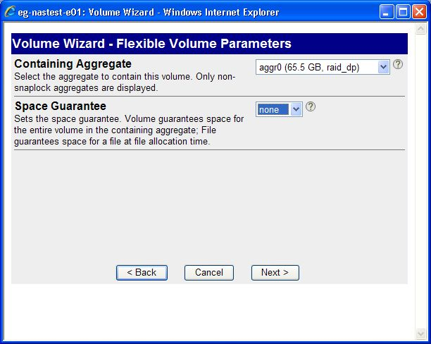
Volume Configuration
The following configuration settings apply for each volume:

Slide 9
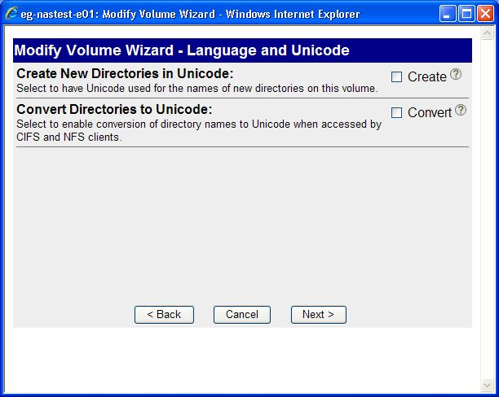
Volume Configuration
The following configuration settings apply for each volume:

Slide 10
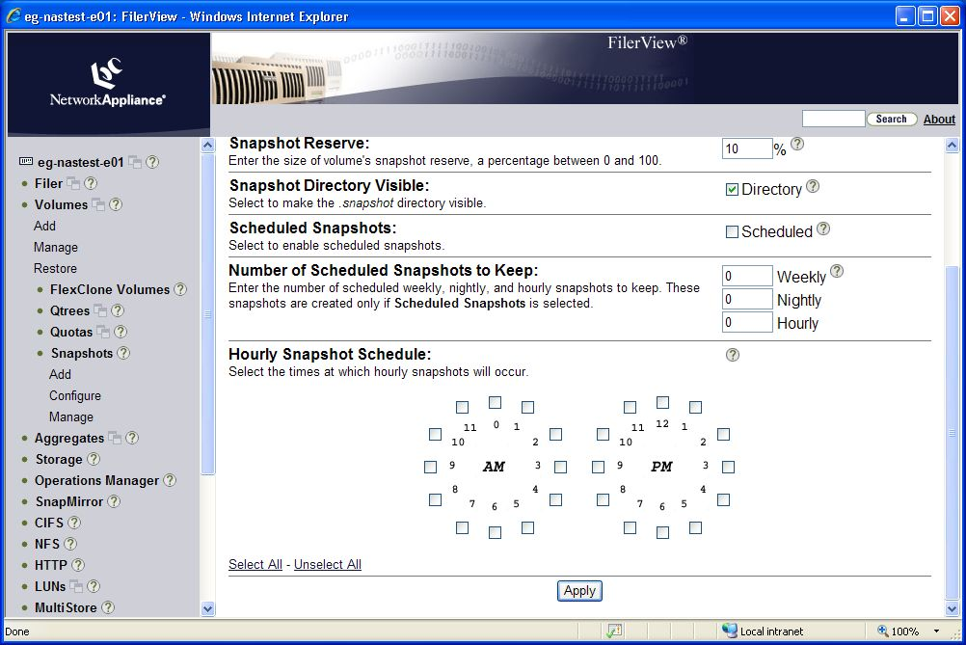
Volume Configuration
The following configuration settings apply for each volume:

Slide 11
Data Deduplication Configuration
NetApp data deduplication will be configured on all primary storage volumes used as VMware datastores.
  The actual deduplication of data is a triggered event and will be set up to run only once per week.
    Run “sis on </vol/volume_name>” and “sis start –s </vol/volume_name>” for all volumes holding VMware data except for the vswap volume.
    Run “sis config –s sat@2 </vol/volume_name>” for all volumes holding VMware data to schedule deduplication to run weekly at 2am every Saturday morning.
    Use the “sis status –l” and “df –s” command to monitor the status of deduplication processes and measure the space savings obtained by deduplication.

